Slide 1
UINT 2
Biosafety guidelines of Government of India
GMOs
LMOs

Slide 2
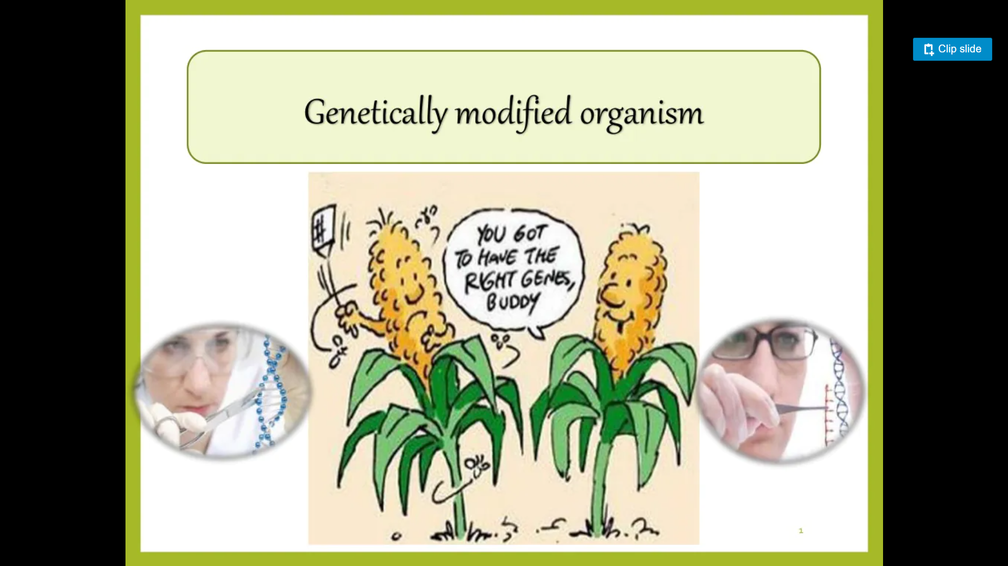

Slide 3
WHAT ARE GENETICALLY MODIFIED ORGANISMS?
A genetically modified organism (GMO) is an organism whose genetic material has been altered using genetic engineering techniques.
Genetic engineering techniques OR Recombinant DNA technology can be used for insertion of genes in plants not only from related plant species but also from unrelated species such as microorganisms.

Slide 4
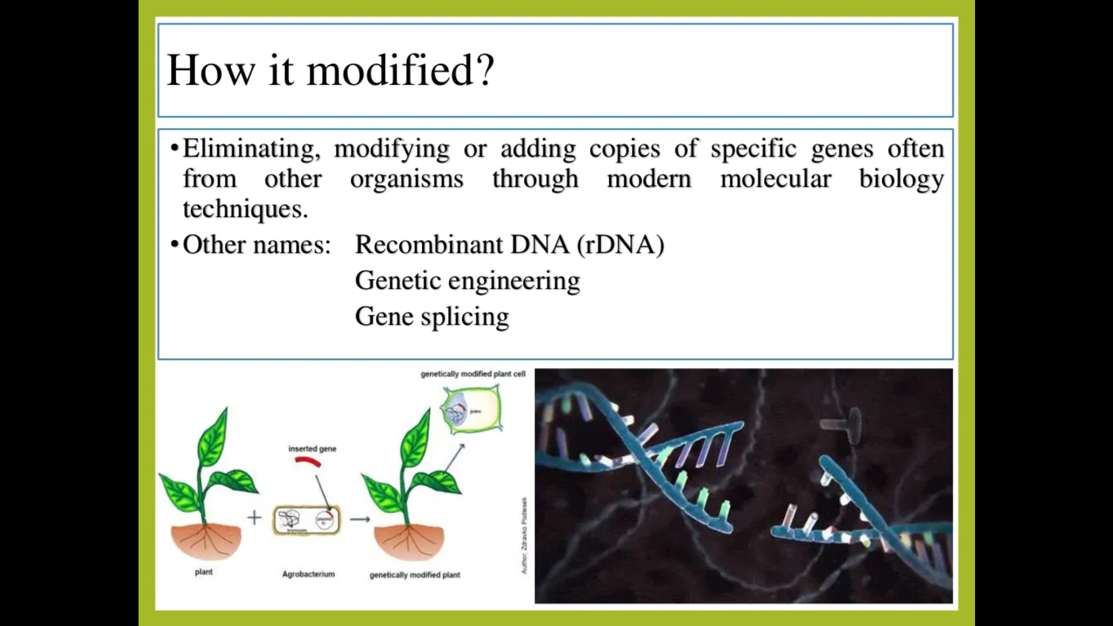

Slide 5
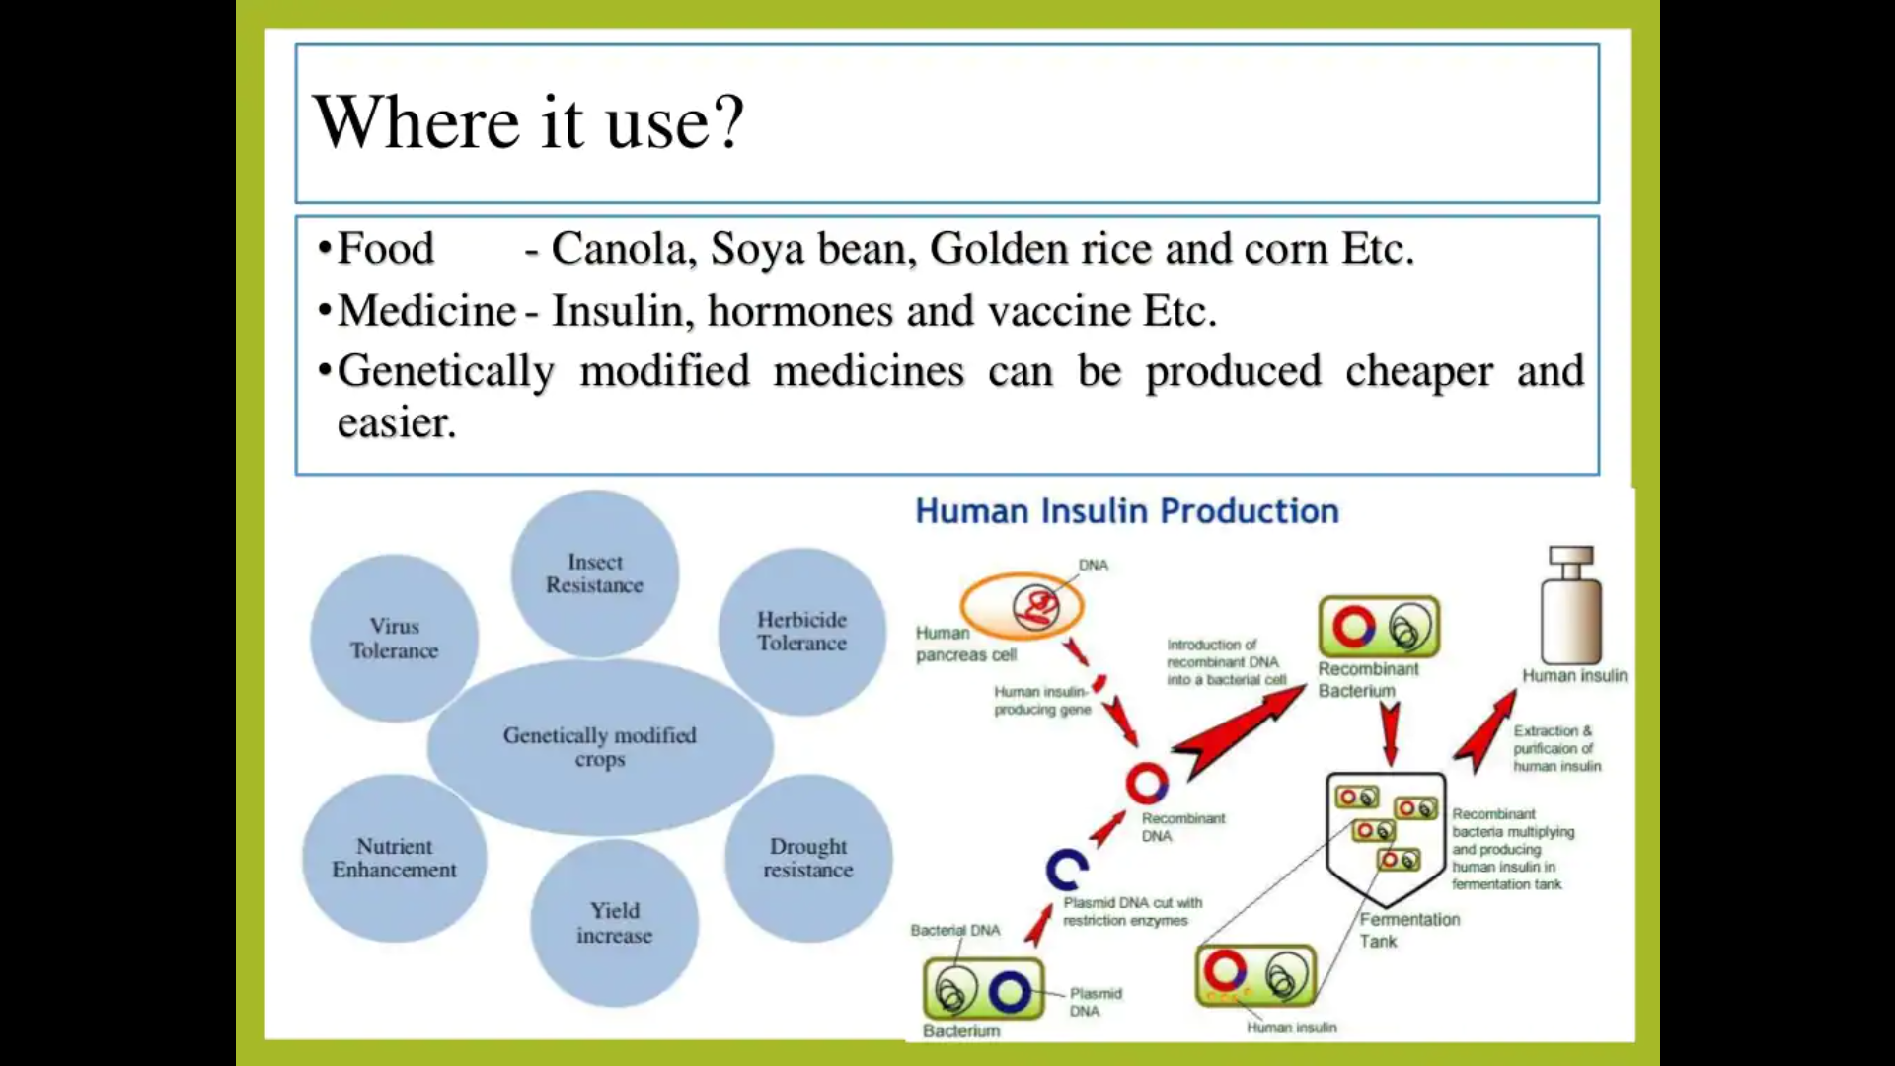

Slide 6
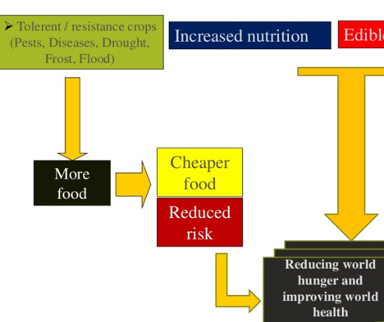

Slide 7
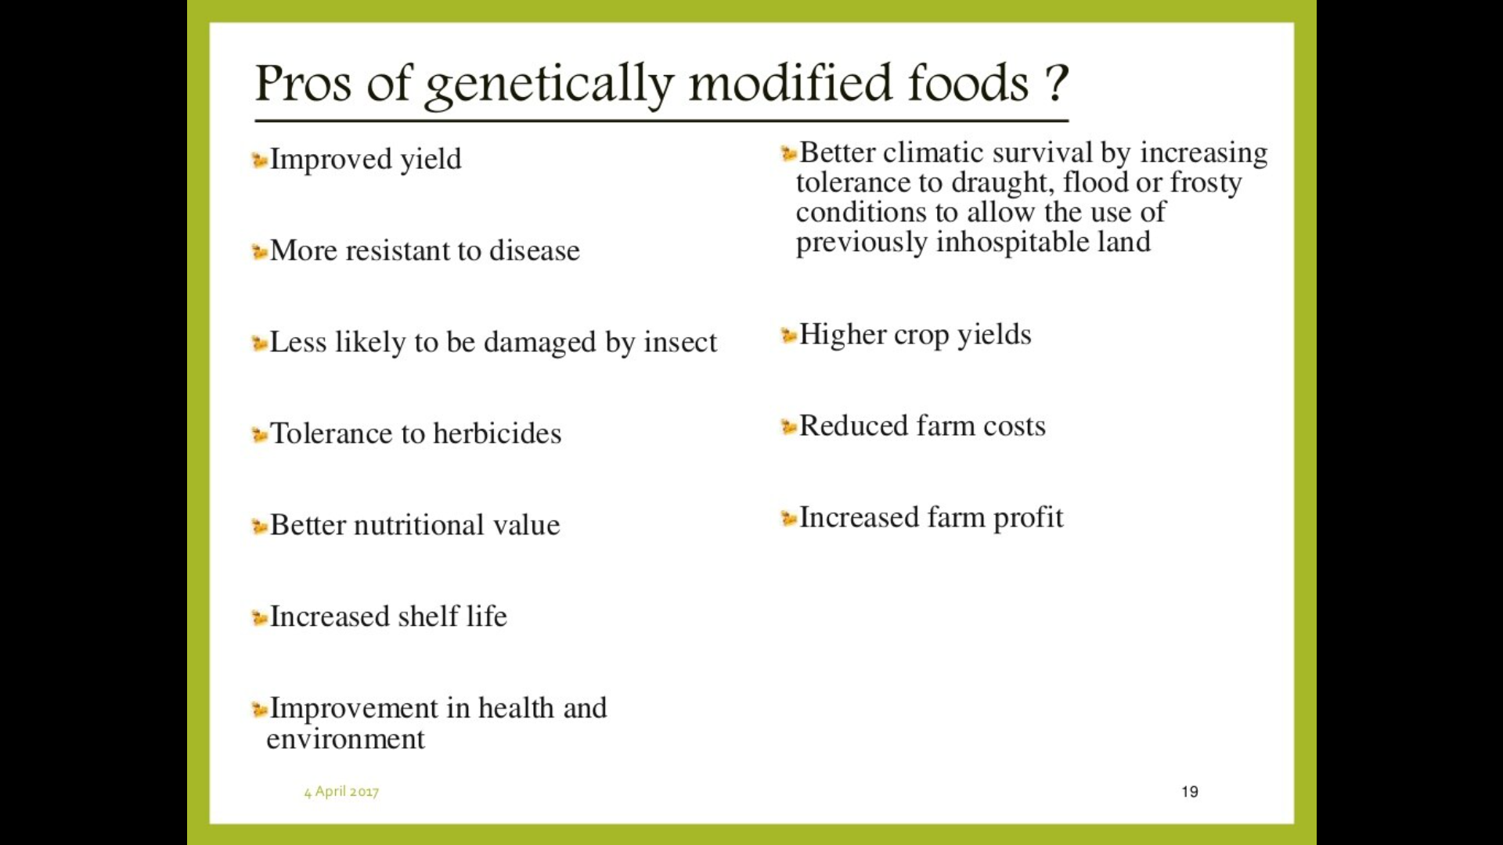

Slide 8
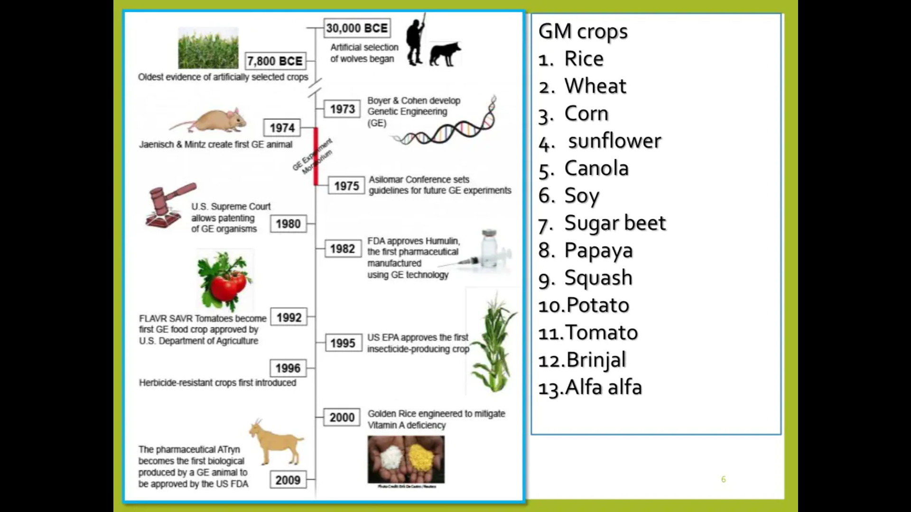

Slide 9


Slide 10
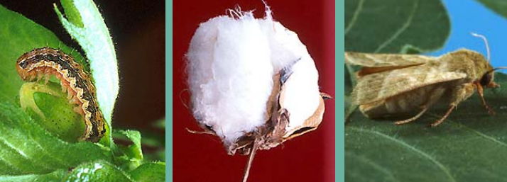
What is Bt cotton ?
BT cotton is a genetically modified pest-resistant plant cotton variety, modified by the insertion of one or more genes from Bacillus thuringiensis (common soil bacteria).
he 'Bt' (Bacillus thuringiensis) genes present in the GM crops kill the insects like bees, ladybird beetles, butterflies, etc. •

Slide 11
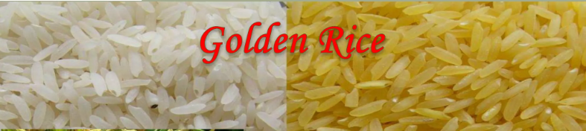
Milled rice is provitamin-A-free.
Symptoms of vitamin A deficiency (VAD) include;
Night blindness,
Increased susceptibility to infection and cancer, anemia (lack of red blood cells or hemoglobin),
Deterioration of the eye tissue, and cardiovascular disease
Nearly 9 million children die from malnutrition each year.
Golden rice is GM crops is yellow because it contains to the β-carotene (provitamin A)

Slide 12
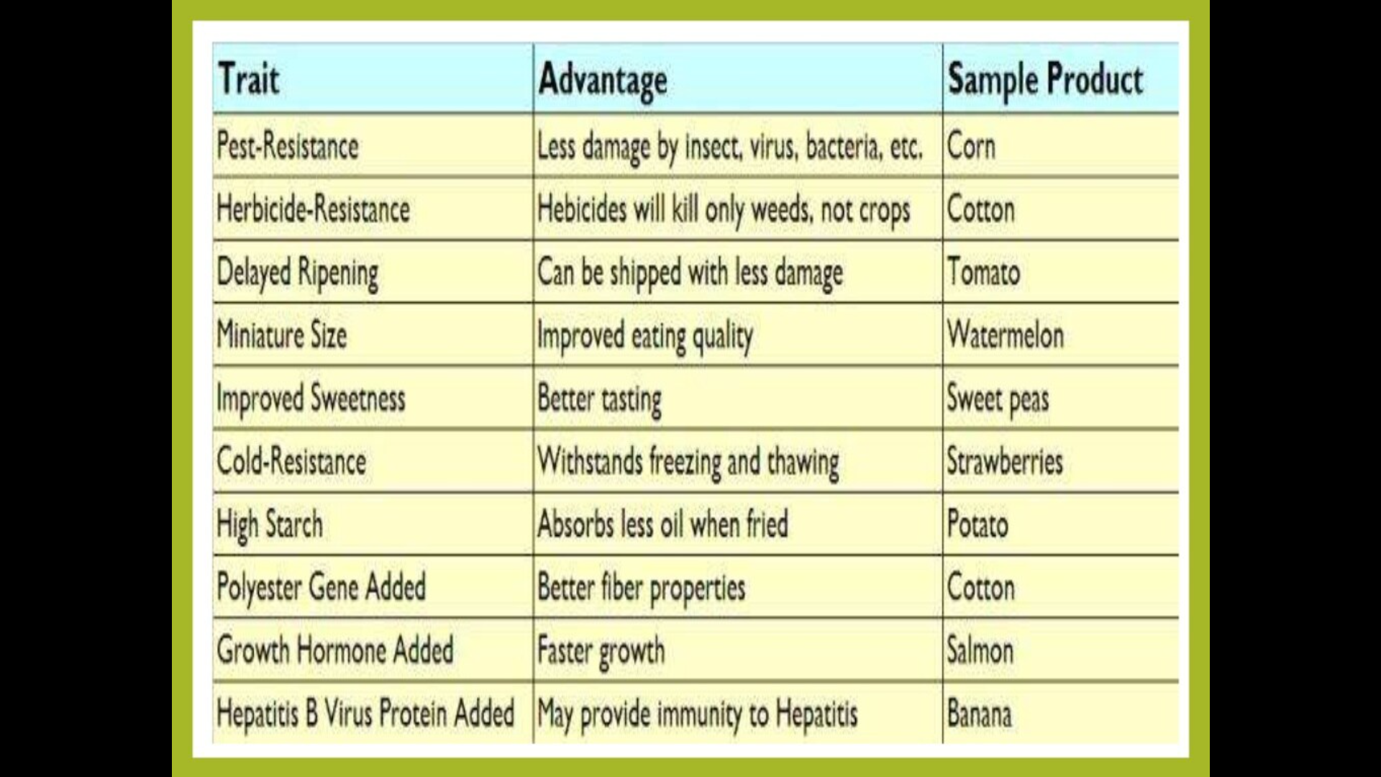

Slide 13
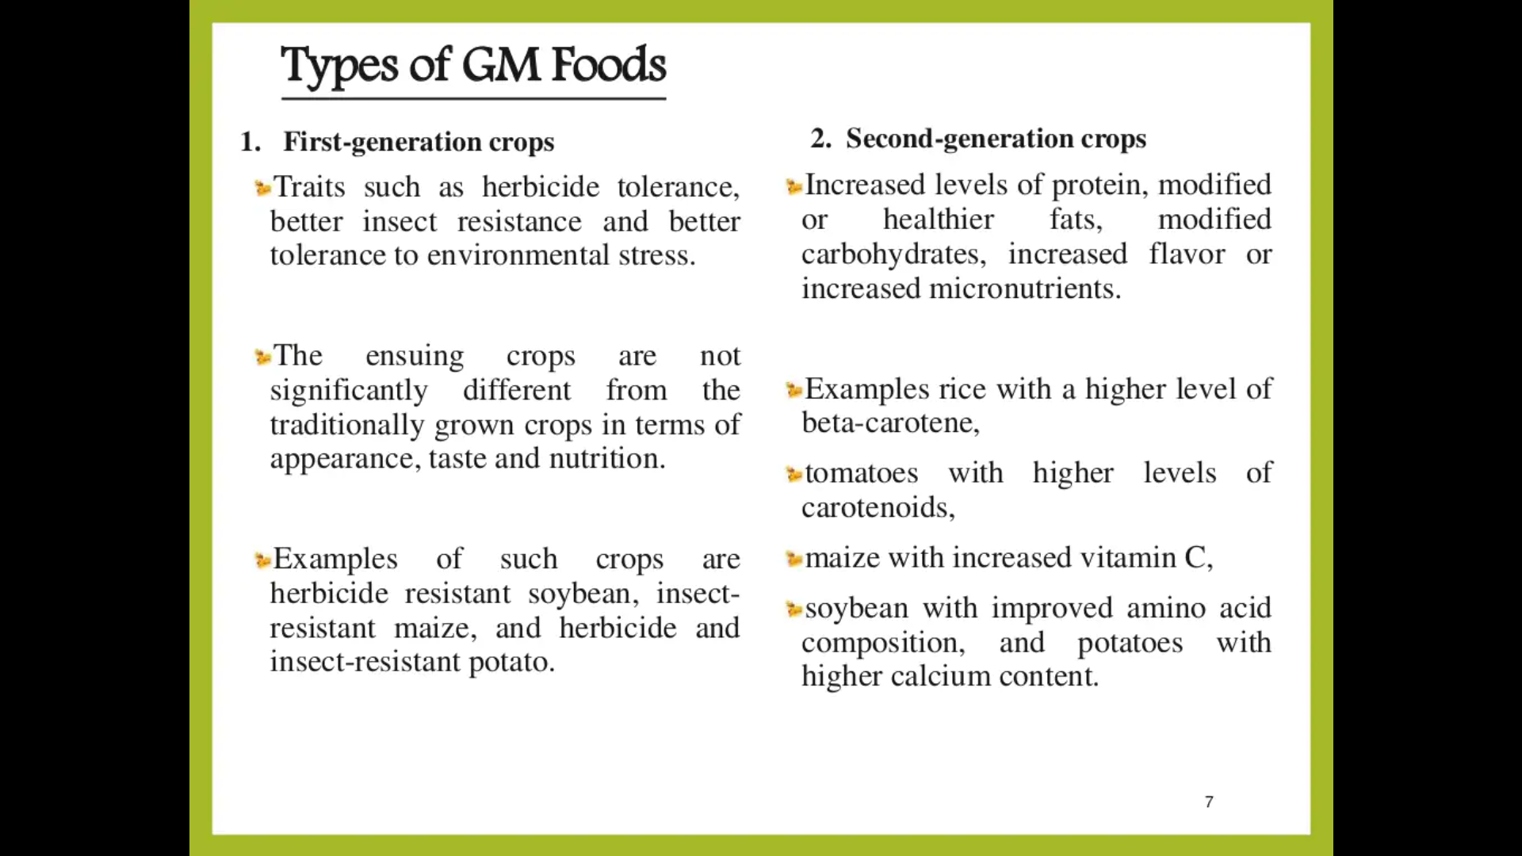

Slide 14
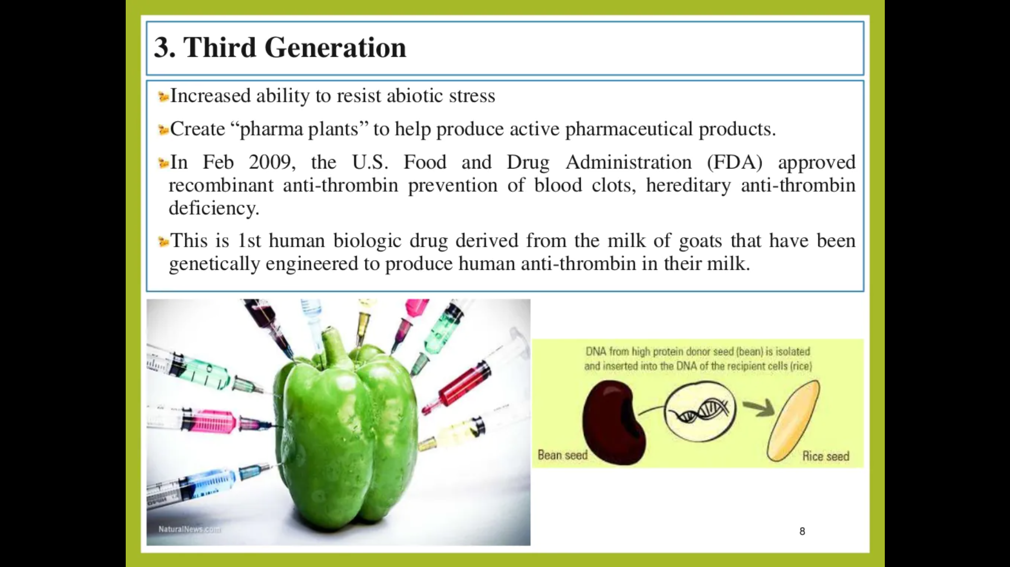

Slide 15
DISADVANTAGES
Risk to Human Health:
GM crops allergen reaction, because GMO foods contain foreign genes,
For example a proposal to incorporate a gene from Brazil nut to soybean was abandoned because of the fear of causing unexpected allergic reaction.
Risks of GMOs to human health are related mainly to toxicity, allergenicity and antibiotic resistance of the new organisms/products.

Slide 16
For example a proposal to incorporate a gene from Brazil nut to soybean was abandoned because of the fear of causing unexpected allergic reaction
GENE FLOW - Accidental cross breeding between GMO plants and traditional varieties through pollen transfer can contaminate the traditional local varieties with GMO genes resulting in the loss of traditional varieties of the farmers. Gene may flow through seed or pollen. The risk of gene flow to the wild relative or related species is raised as threat to the biodiversity in might causing unpredictable change on the ecology in total.
Loss of Biodiversity
destructive situations increases when single varieties are used in cropping system in place of multiple varieties.
Changes in the soil ecology:
transgenic plants may leak different compounds than conventional plants,
Risks associated with use of bacterial resistance genes in the generation of GM plants

Slide 17
Loss of Biodiversity :
The use of some GM crops can have negative impacts on non-target organisms and on soil and water ecosystems.
For example, GM herbicide-tolerant corn and soy, will destroy all types insects
Changes in the soil ecology:
transgenic plants may leak different compounds than conventional plants,

Slide 18
Regulatory Mechanism
India has a well-defined regulatory mechanism for development and evaluation of GMOs
The Department of Biotechnology (DBT) and the Ministry of Environment & Forests (MoEF) are the two apex regulatory bodies
Rules have been notified by MoEF in 1989 under Environmental Protection Act, 1986 (EPA),
These rules cover procedures for the manufacture, import, use, research and release of GMOs as well as products
The objective of the rule is to ensure that the use of GMO is safe to the environment and beneficial to the human beings.

Slide 19
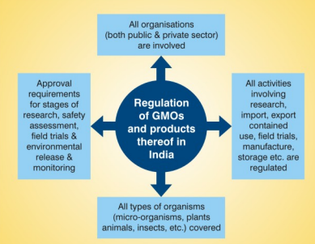

Slide 20
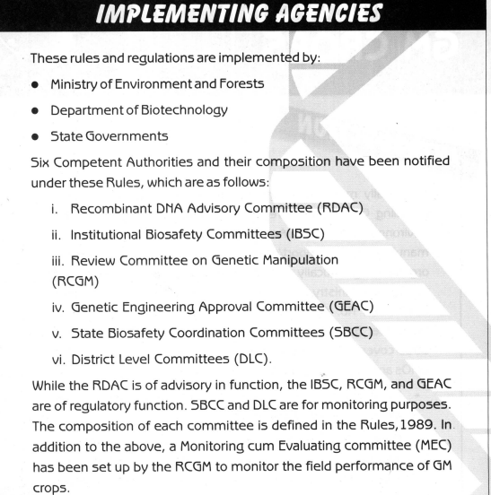

Slide 21
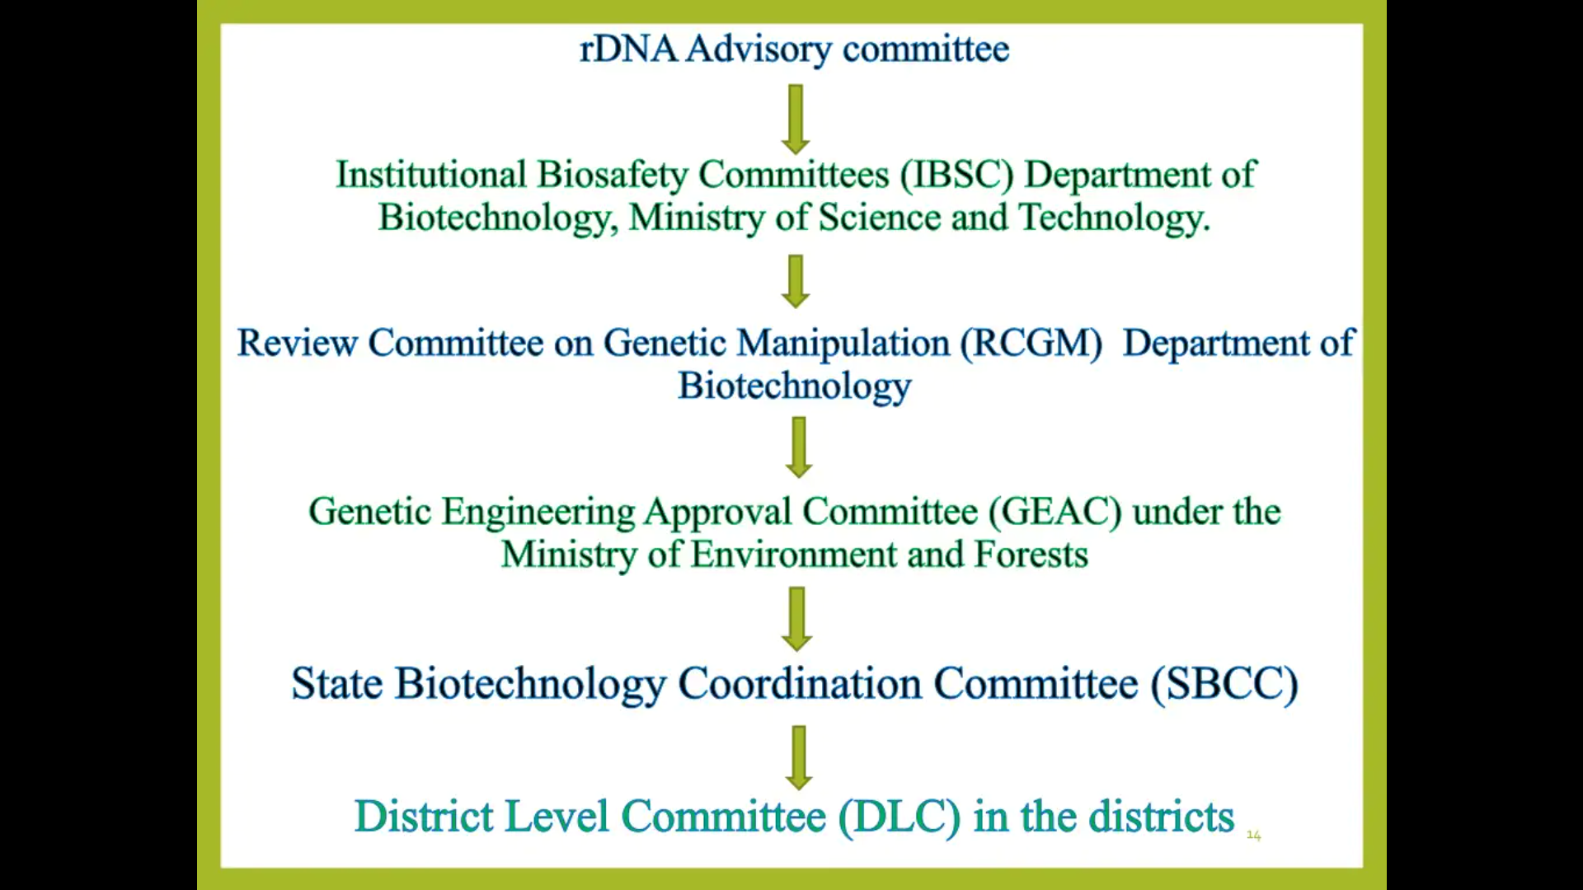

Slide 22
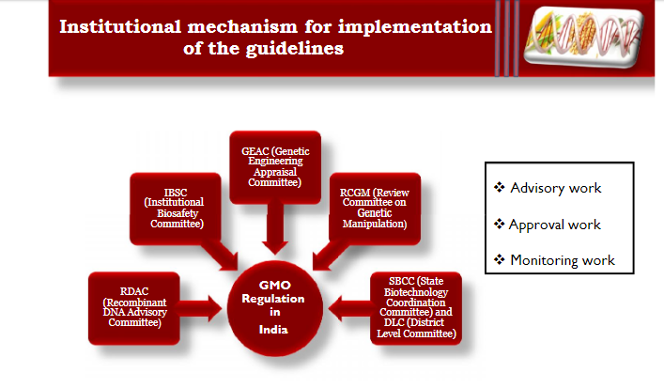

Slide 23
Recombinant DNA Advisory Committee
The Advisory Committee functions under the Department of Biotechnology.
The Committee scrutinizes national and international biotechnology developments.
It shall make periodic recommendations, suitable and appropriate safety regulations', for GMO research and application.
The Committee is to develop the long-term policy for research and development and educate researchers and technicians on the hazards and the methods to avoid those hazards.

Slide 24
Review Committee on Genetic Manipulation (RCGM) The RCGM is constituted by the Department of Biotechnology to monitor safety related aspects in the ongoing research projects and activities involving genetically engineered organisms or micro-organisms. The Committee also brings out manuals on guidelines with respect to activities involving GMOs in research, use and applications. Every ongoing project involving 'high-risk category and control1ed field experiments' requires review by the RCGM for ensuring strict adherence to adequate precaution and containment.

Slide 25
Genetic Engineering Approval Committee (GEAC) Apex Body
The GEAC functions under the Ministry of Environment and Forests and is responsible for approval of activities involving large-scale use of GMOs in research, industrial production and application.
The GEAC issues clearance only from the environmental angle.
The Committee authorises release of GMOs and products into the environment, including field trials.
That means large-scale experiments beyond RCGM's jurisdiction have to be authorized by the GEAC only

Slide 26
State Biotechnology Co-ordination Committee (SBCC)
The SBCCs can 'inspect, investigate and take disciplinary actions' against statutory violations through the nodal department and the State Pollution Control Board or the Directorate of Health or Medical Services.
The Committee shall undertake periodic; reviews of the safety and control measures in industries and institutes.
District Level Committee (DLC)
The DLCs at the district levels are to monitor the safety regulations in insta1Iations.
The DLC or its representatives shall make on-site visits and find out hazards and risks associated, with a view to meeting any emergency.
They shall prepare off-site emergency plans and shall regularly submit reports to the State Biotechnology Co-ordination Committee or the Genetic Engineering Approval Committee

Slide 27
Institutional Bio-safety Committee (IBSC)
The Committee shall consist of the head of the institution, a medical expert, a scientist well versed in DNA work and a candidate of the DBT.
The research institution shall prepare an updated on-site emergency plan (with the help of the IBSC) according to the manual or guidelines of the Review Committee of Genetic Manipulation.
The copies of the plans shall be served to the State, District Level Committees and the Genetic Engineering Approval Committee. A designated
Principal Investigator (P.I.) in every research organization should explain the Institutional Bio-safety Committee about the nature of experiments being carried out.
The Investigator should obtain permission from the Institutional Bio-safety Committee or from the Review Committee of Genetic Manipulation through the Institutional Bio-safety Committee , if the risk falls in a higher category.

Slide 28
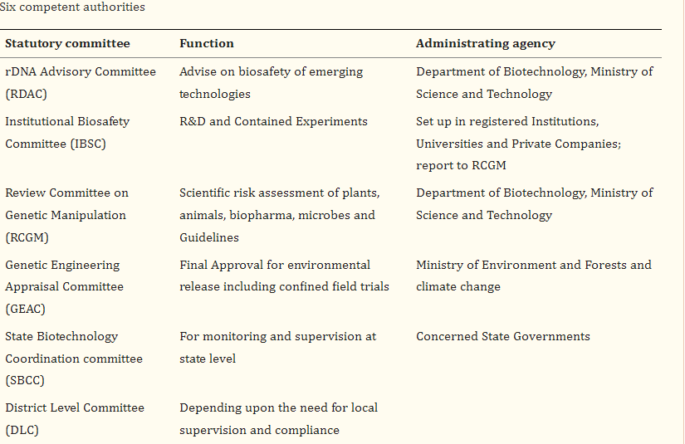

Slide 29
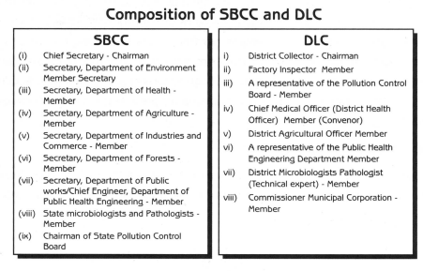

Slide 30
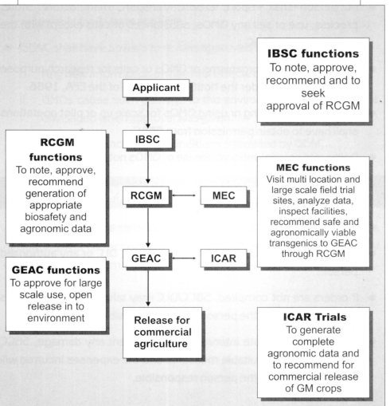

Slide 31
Cartagena Protocol
Convention on Biological Diversity (CBD)
The Convention on Biological Diversity (Biodiversity Convention, CBD) was adopted at the United Nations Conference on Environment and Development (UNCED) in Rio de Janeiro in 1992. The Convention now has a total of 193Parties. It was ratified by Switzerland in 1994.
The signatory states of the CBD undertake to conserve biodiversity in their own territories, support appropriate measures for the conservation and sustainable use of biodiversity in developing countries, and regulate equitably the access to genetic resources and their utilization.

Slide 32
The Cartagena protocol on biosafety
Introduction
The Convention on Biological Diversity was finalized in Nairobi in May 1992 and opened for signature at the United Nations Conference on Environment and Development (UNCED) in Rio de Janeiro on 5 June1992. It entered into force on 29 December 1993. Today, the Convention is the main international instrument for addressing biodiversity issues. It provides a comprehensive and holistic approach to the conservation of biological diversity, the sustainable use of natural resources and the fair and equitable sharing of benefits deriving from the use of genetic resources. Biosafety is one of the issues addressed by the Convention.

Slide 33
This concept refers to the need to protect human health and the environment from the possible adverse effects of the products of modern biotechnology. At the same time, modern biotechnology is recognized as having a great potential for the promotion of human well-being, particularly in meeting critical needs for food, agriculture and health care. The Convention clearly recognizes these twin aspects of modern biotechnology. On the one hand, it provides for the access to and transfer of technologies, including biotechnology, that are relevant to the conservation and sustainable use of biological diversity. On the other hand, it ensure the development of appropriate procedures to enhance the safety of biotechnology in the context of the Convention’s overall goal of reducing all potential threats to biological diversity, taking also into account the risks to human health.

Slide 34
At its second meeting, held in November 1995, the Conference of the Parties to the Convention established an Open-ended Ad Hoc Working Group on Biosafety to develop a draft protocol on biosafety, focusing specifically on transboundary movement of any living modified organism resulting from modern biotechnology that may have adverse effect on the conservation and sustainable use of biological diversity. After several years of negotiations, the Protocol, known as the Cartagena Protocol on Biosafety to the Convention on Biological Diversity, was finalized and adopted in Montreal on 29 January 2000 at an extraordinary meeting of the Conference of the Parties.

Slide 35
The conclusion of the Biosafety Protocol has been hailed as a significant step forward in that it provides an international regulatory framework to reconcile the respective needs of trade an environmental protection with respect to a rapidly growing global industry, the biotechnology industry. The Protocol thus creates an enabling environment for the environmentally sound application of biotechnology, making it possible to derive maximum benefit from the potential that biotechnology has to offer, while minimizing the possible risks to the environment and to human health.

Slide 36
The Protocol was adopted on 29th January 2000 and entered into force from September 11, 2003. As on date, 135 countries have approved the Protocol
India approved the Protocol on January 23, 2003 and the Ministry of Environment & Forests (MoEF) is the nodal ministry for implementation of Cartagena Protocol.
The main function of Conference of Parties is to review the implementation of the Protocol and make decisions necessary to promote its effective operation.

